Slide 1

Roles and responsibilities at Oakley CE Junior School
Would you like a role and responsibility at our school?
Have a look at all the different roles and responsibilities on offer and decide if you would like to apply for one.

Slide 2
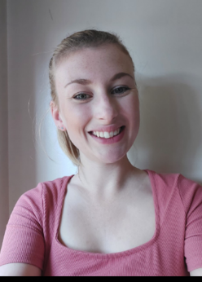

Do you have lots of ideas and opinions?
Are you good at working in a team?
Are you keen to help others?
Can you talk confidently in front of the whole school?
Mrs Badham will be helping you in the school council.
I will meet with you about every 4 weeks, at lunchtime, in one of the classrooms.
In between meetings, you will need to collect ideas from your class and tell them about our plans.
If you think this job is for you, collect an application form now!
This role is just for year 3, 4 and 5.

Slide 3
The following roles are for year 3, 4 and 5 and 6:

Slide 4

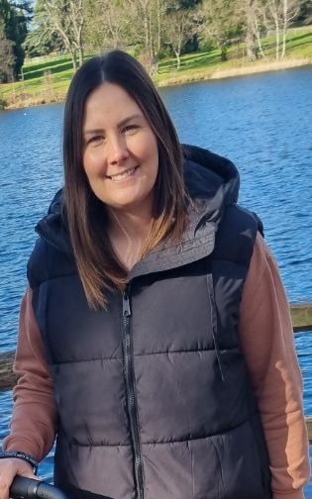
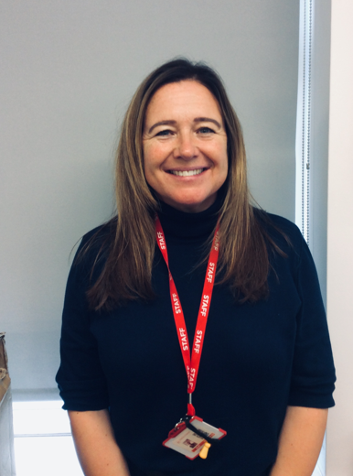
Sports Leader
Roles and Responsibilities
You will be expected to show:
Great leadership qualities
An interest and confidence in sports
Willingness to share ideas around sports and PE
You will be expected to undertake roles such as:
Run and organise sport events such as sports day.
Lead active sessions during lunchtime to engage children within different types of sports and activities. This will be on a rota basis for 30 minutes during the lunch hour.
Help ensure that the PE equipment is looked after and kept tidy.
Support teachers with getting their PE lessons ready by getting equipment out and putting them away correctly.
Who will help me?
Mrs Prentice and Mrs Gilsenan
When and where will we meet?
We will sometimes meet on a Friday lunchtime. We usually meet once a half-term. Mrs Prentice and Mrs Gilsenan will always tell you when there is a meeting.

Slide 5

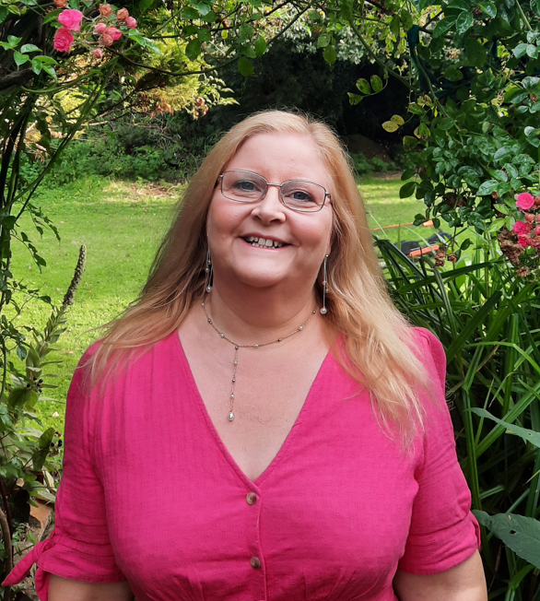
Spirituality Leader
Roles and Responsibilities
1 child per class
You will be expected to show:
Compassion for others
Wonder for the world around us
Willingness to be part of Collective Worships.
An interest in religion
You will be expected to undertake roles such as:
Have responsibility for class Prayer Corners
Sometimes lead Collective Worship
Help with Prayer Spaces
Help set up Collective Worships in the hall
Who will help me?
Mrs Sworder and Sochi
When and where will we meet?
We will meet some Thursday lunchtimes at 12:30.

Slide 6

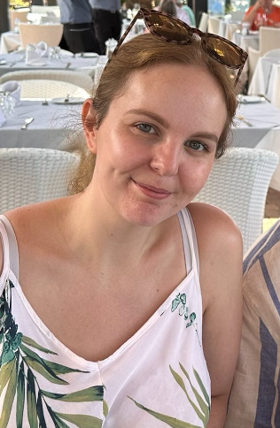
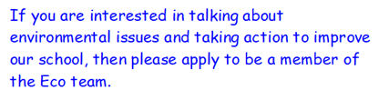
Join the Eco Team if your passionate about making this school more eco-friendly!
The team will:
Meet half termly
Carry out work around the school to build sustainability
Consider ways how we can reduce, reuse and recycle
Carry out litter picking
Lead collective worships about how to be eco-friendly
Speak to your classes and others about what we are doing in the team
ECO TEAM with Mrs King

Slide 7

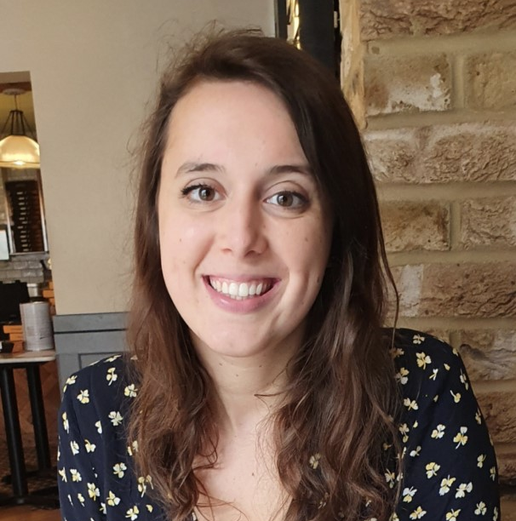
What would my responsibilities be?
Digital
Leaders
Going to other classes, helping and explaining how to be safe online.
Creating posters and coming up with other creative ways to encourage and help everyone become safer on the internet!
Leading the Safer Internet
Day assembly in February.
Have regular meetings
during lunchtime to discuss
projects and plans.
Checking that laptops/
iPads are being properly
stored.
What makes a good Digital Leader?
Someone who:
- is confident using technology and can problem solve.
- can work well with others and help other children.
- has lots of ideas about how to help everyone become safer online!
Led by Mrs Semple

Slide 8
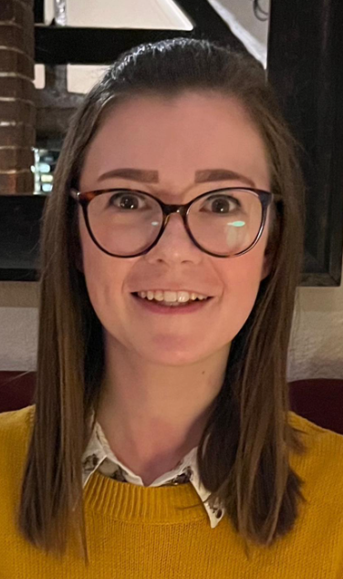


Responsibilities:
To take in your class weekly scores for our Weekly Listening Challenge.
To support with the music choices for collective worships, assemblies and the Weekly Listening Challenge.
To help teachers with music equipment for lessons and ensuring this is kept tidy in the music room.
To support the front of house team at performance events in school such as the Year 6 Leavers Production, Year 4 Christmas Production and other performances throughout the year.
Performance Leaders
1 child per class.
As a Performance Leader you will need to be confident and have a love for music. You don’t need to be able to play an instrument or have experience in performing but have the desire to want to share music with others. You will also need good listening skills.
We will meet twice a half term to discuss your class scores for the Weekly Listening Challenge, to discuss upcoming events and how we can share our love for music at our school.

Slide 9
The following role, on the next slide, is just for year 5:

Slide 10

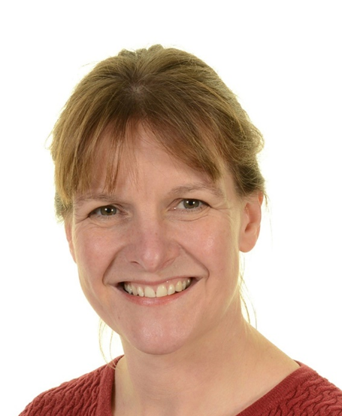
Maths Ambassadors
Role and responsibilities:
To help run the maths weekly problem challenge for the whole school and announce the winners in our celebration assembly each week.
To help to plan a special maths day in November.
To be ambassadors for maths at our maths parent evening later in the year.
To help choose and order some outdoor maths games.
To create an Easter maths trail for Upper and Lower School in the spring term.
To help to design a maths escape room challenge for Years 2 – 5 in the summer term.
To help with the calculation of house point scoring on our school Sports Day.
To talk about maths in our school to visitors and our maths governor.
Mrs Podevin, our school maths leader, is looking for four year 5 pupils to promote a love of maths in our school.
‘I am looking for people who love maths and are creative thinkers.’

Slide 11
Due to training the EARA and JRSO group have received, the children in year 4, 5 and 6 will continue in their role. However, we would like year 3 children to apply.
Please see the next slides for more information-

Slide 12
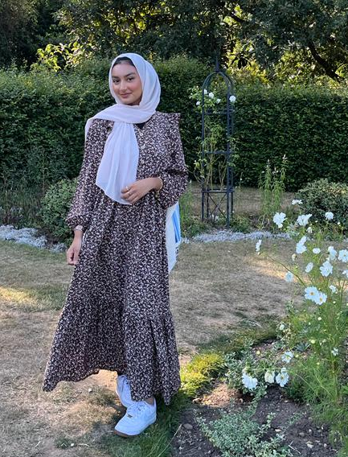


Equalities and Rights Advocates (EARA)
What does EARA mean?
EARA stands for Equality and Rights Advocates. At Oakley, we believe that everyone has the right to be treated with equality, respect and have their voices listened to. We follow the children's rights from the United Nations Conventions of the Rights of the Child.
What will you do?
As EARA’s it will be our mission to:
Ensure that everyone is heard
Ensure that everyone feels valued and respected
Spread awareness of children’s rights
Ensure that our school community respects equity and equality
Miss Rahman

Slide 13
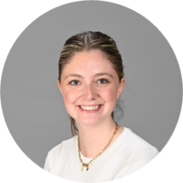
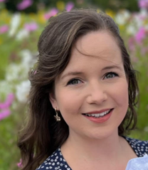

Junior Road Safety Officers led by Miss Silcox and Miss Collier
Become a vital part of Oakley CE Junior school and help to develop road safety awareness. Help to promote road safety issues to everyone in the school and wider community.
Responsibilities:
Leading assemblies about how to make safe choices near roads
Organise competitions and campaigns to raise awareness about road safety
Be willing to meet once a month to discuss our activities

Slide 14
Please hand in your application form to your class teacher by:
Friday 18th October
The week beginning Monday 21st October will be our Democracy Week in school. The roles will be allocated by
Thursday 24th October

